Slide 1
Innovation & Futamura
CLEP Innovation Workshop April 2022

Slide 2
Notes:
Japanese owned with UK management structure
300 employees Wigton (1500 worldwide)
Leading global producer of compostable cellulose based packaging films

Slide 3
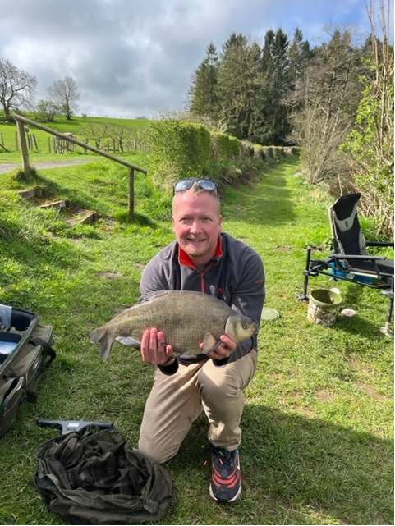
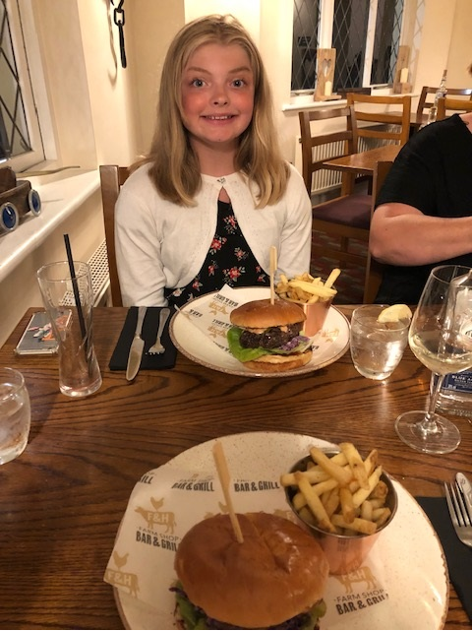
Agenda: 15 minutes covering 3 key topics…..
What is innovation and why is it important to us as a business.
How do we approach innovation?
A few sneak peeks of what we’re up to
Challenges:
The pitfalls of innovating in a long established business, using a 100year old process, in the depths of Cumbria…….
What helps to overcome them (scientific progress, teamwork, suppliers, etc…)
Notes:
Free reign…….

Slide 4
What is Innovation?
Innovation
NOUN
the action or process of innovating.
"innovation is crucial to the continuing success of any organization"
synonyms:
change · alteration · revolution · upheaval · transformation · metamorphosis · reorganization · restructuring · rearrangement · recasting · remodelling · [More]
a new method, idea, product, etc..
"technological innovations designed to save energy“
Innovate
VERB
innovate (verb) · innovates (third person present) · innovated (past tense) · innovated (past participle) · innovating (present participle)
make changes in something established, especially by introducing new methods, ideas, or products.
"the company's failure to diversify and innovate competitively"
synonyms:
originate · create · design · devise · contrive · formulate · develop · conceive · think up · come up with · hit on · mastermind · pioneer · discover · find · coin · mint
introduce (something new, especially a product).
"we
continue to innovate new products“
Notes:
Point out synonyms in the NOUN

Slide 5
Imagine the future world…. Understand your place in it.. “Remain Relevant”
Notes:
The way I wrap this up, for Futamura is……..

Slide 6
Look out for the opportunities of a changing world and the ideas you create
Notes:
Know when to diversify……………
Natureflex concived over 30years ago and today is

Slide 7
Research Portfolio Strategy……..
Plan for the Future
Support the Here and Now
Learn from the Past

Slide 8
Future Proofing Strategy (What’s our Vision)
1890’s Pulp & Process
Viscose
1930’s
Casting
1950’s Coating
Solvent Based Dip Coating
Pulp & Process
High efficiency, Low carbon and virtually chemical free Dissolution system
Coating
Water Based Gravure Coating compostable films
Casting
Film hybrids with cellulose purified from waste organic material

Slide 9
You mentioned Challenges……
Being Heard at National Level
“The pitfalls of innovating in a long established business, using a 100year old process, in the depths of Cumbria?”
What could be hard about that?
Resource
Predicting Government Policy
Access to applicable high-quality training
Location
Perception
Expertise
Finger on the technological pulse?
Funding
Old Fashioned or Cutting edge?
Access to facilities
(Pilot, Analytical etc)
Pace of change
Sometimes too fast for the business but too slow for the world
Applicable experience?

Slide 10
Three Key Principles for stronger Innovation
#1 - Have a Clear Vision
Notes:
Know when to diversify……………
Natureflex concived over 30years ago and today is

Slide 11
#2 – Spend time building a strong external network (Look near and far for “good” partners and suppliers…..

Slide 12
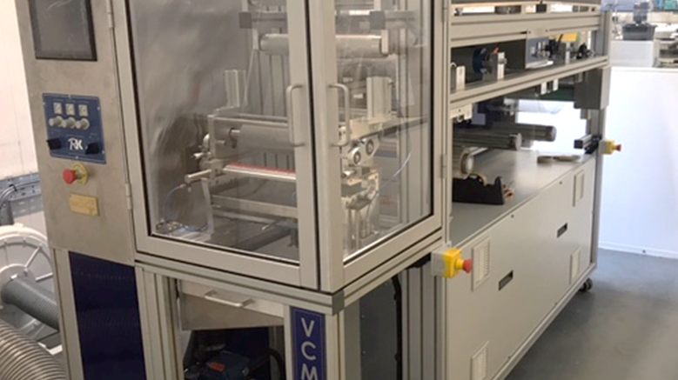
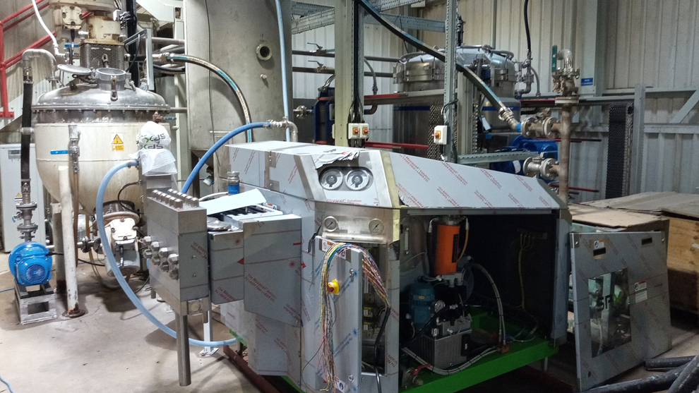
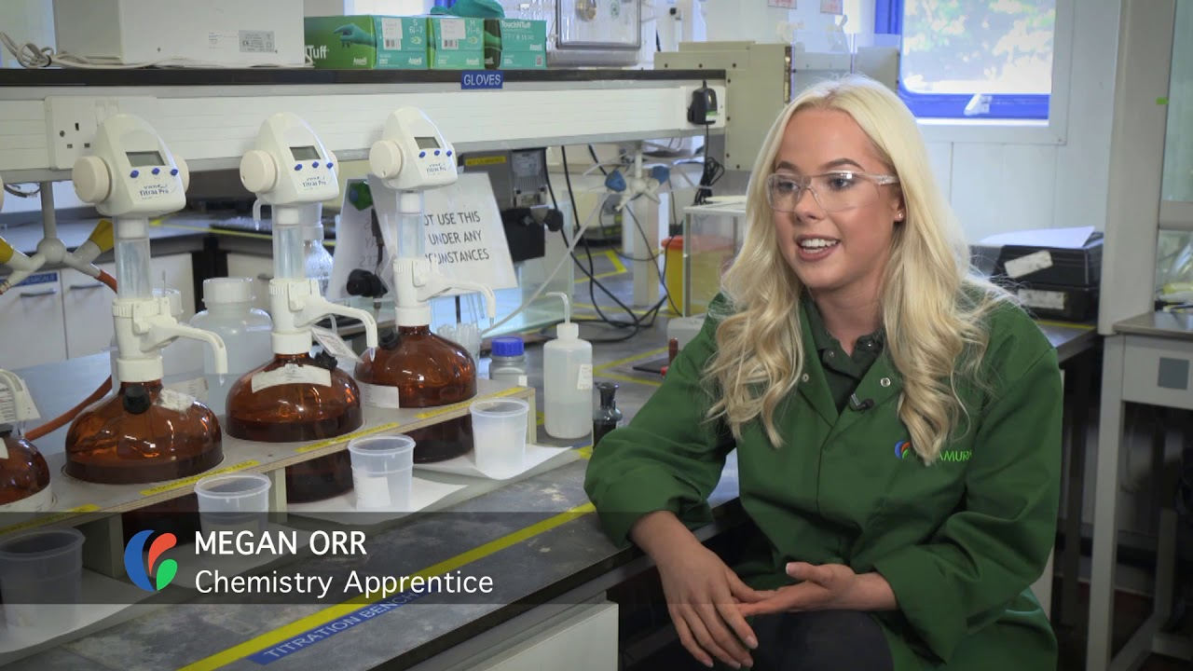
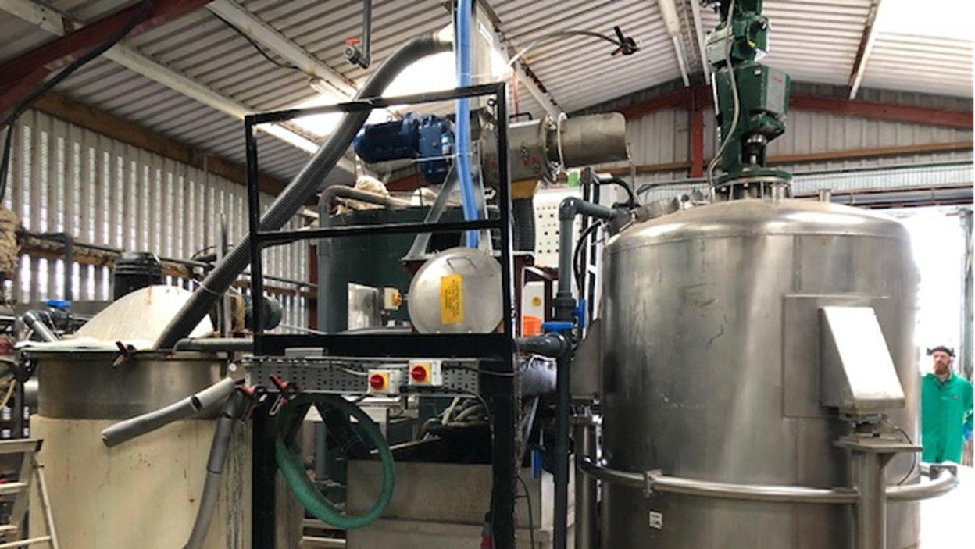
#3 - Invest in the Future. Even when times are Hard

